Slide 1

Department of CSIT
COURSE NAME
FOUNDATIONS OF CLOUD-NATIVE COMPUTING & DEVOPS
COURSE CODE –24CS2260F
Topic:
lightweight observability: kubectl logs, container logs, nodemetrics
Session -

Slide 2
What is Observability?
Observability means understanding what is happening inside your application and cluster.
In Kubernetes, applications run across many pods and nodes, so it becomes difficult to find issues.
Observability helps us:
Find errors
Monitor performance
Debug problems quickly

Slide 3
What is Lightweight Observability?
Lightweight observability means:
Using simple built-in Kubernetes tools (like kubectl) to monitor and debug, without using heavy tools like Prometheus or Grafana.
✔ No complex setup ✔ Fast debugging ✔ Suitable for small clusters or development environment

Slide 4
Observability Signals in Kubernetes
Kubernetes observability is based on three key signals:
Logs: Application and container output
Metrics: CPU and memory usage
Events: System-generated state changes
Lightweight observability mainly uses logs, basic metrics, and events accessed via kubectl to monitor applications

Slide 5
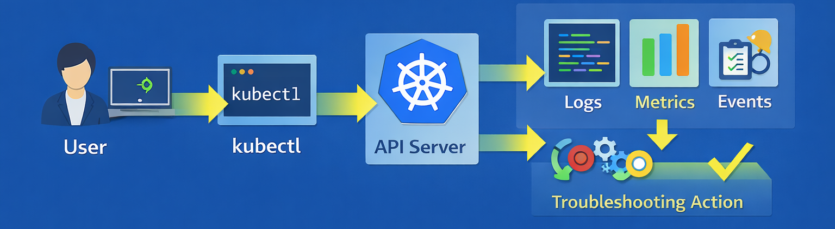
Lightweight Observability Workflow
Operators use kubectl to collect logs, metrics, and events. Based on this information, they diagnose issues, adjust configurations, or trigger corrective actions such as restarts or rollbacks.

Slide 6
Observability Signals in Kubernetes
1. Logs
Show what the application is doing
Help identify errors
Use case: Debug application failure
Command:
kubectl logs <pod-name>
Example:
kubectl logs webapp-pod
Output:
Error: Database connection failed

Slide 7
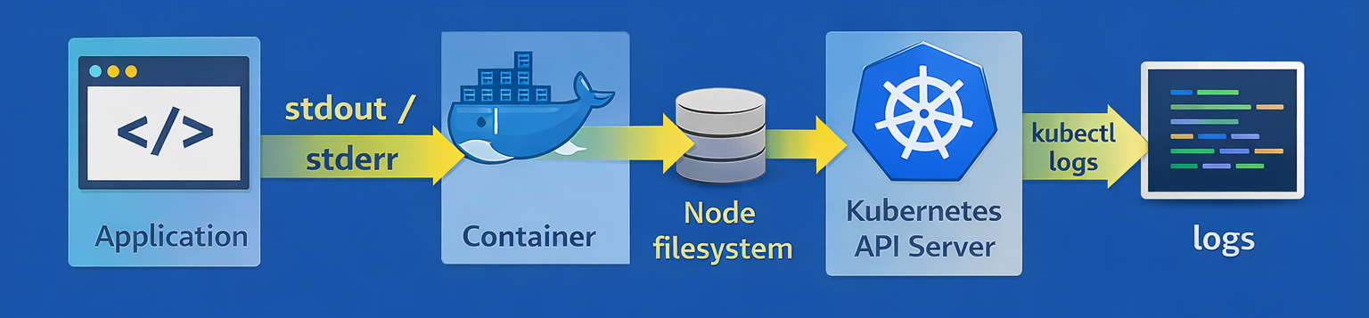
Container Logs Architecture
Containers write logs to standard output. Kubernetes stores these logs on the node, and kubectl logs retrieves them through the API Server.

Slide 8
2. Kubernetes Events
Events provide contextual information about what is happening in the cluster, such as scheduling decisions, restarts, and failures.
Events are useful for understanding why pods fail or are delayed.
View events:
kubectl get events
Events complement logs by explaining system-level behavior.

Slide 9
3. Node and Pod Metrics
Metrics provide quantitative information about resource usage.
Lightweight observability relies on metrics-server to collect basic CPU and memory metrics from nodes and pods.
Metrics help identify overloaded nodes or inefficient workloads.
Viewing Node Metrics: Node-level metrics show how much CPU and memory each node is using.
Command:
kubectl top node
This command helps detect resource pressure and capacity issues at the node level.

Slide 10
Viewing Pod Metrics - Pod-level metrics provide insight into resource usage by individual applications.
Command:
kubectl top pod
Output:
webapp-pod CPU: 80% Memory: 500Mi
This is useful for tuning resource requests and limits and identifying resource-hungry pods.

Slide 11
Examples
Scenario 1: Application Not Working (Check Logs)
Situation
A developer deploys an app, but it is not responding.
Step-by-Step Process
Step 1: Check running pods
kubectl get pods
Find your pod name (example: webapp-pod)

Slide 12
Step 2: View logs
kubectl logs webapp-pod
You may see error like:
Error: Port already in use
Step 3: Fix the issue
Change port in YAML file
Redeploy application
kubectl apply -f deployment.yaml

Slide 13
Scenario 2: Pod Crashing (CrashLoopBackOff)
Situation
Pod is continuously restarting.
Step-by-Step Process
Step 1: Check pod status
kubectl get pods
Output:
webapp-pod CrashLoopBackOff

Slide 14
Step 2: Check previous logs
kubectl logs webapp-pod --previous
Example error:
Database connection failed
Step 3: Fix issue
Check database config
Update environment variables
kubectl apply -f deployment.yaml

Slide 15
Scenario 3: High CPU Usage (Node Metrics)
Situation
Cluster becomes slow.
Step-by-Step Process
Step 1: Check node usage
kubectl top node
Output shows:
CPU usage
Memory usage
Step 2: Identify overloaded node
Example:
node1 CPU: 95%
Step 3: Take action
Move workload
Scale cluster

Slide 16
Scenario 4: Which Pod is Using More Resources
Situation
One application is consuming too much memory.
Step-by-Step Process
Step 1: Check pod metrics
kubectl top pod
Step 2: Identify heavy pod
Example:
webapp-pod CPU: 80% Memory: 700Mi

Slide 17
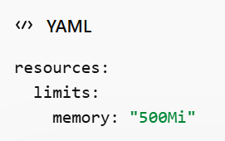
Step 3: Fix issue
Optimize code OR
Add limits in YAML

Slide 18
Limitations, Best Practices, and Summary
Limitations:
Lightweight observability does not provide long-term storage or advanced analytics.
Logs and metrics may be lost when pods restart or nodes fail.
Best practices include combining logs, metrics, and events, and using lightweight observability for quick debugging while adopting full monitoring stacks for large production environments.
Summary: Lightweight observability uses built-in Kubernetes tools such as kubectl logs, events, and kubectl top to provide essential visibility into cluster behavior and application health, supporting production-ready operations.

Slide 19

THANK YOU
Team –Foundations Of Cloud-native Computing & Devops

